Slide 1

Computer Programmer

Slide 2
FPS Inventory

Slide 3

Developed by:

Slide 4


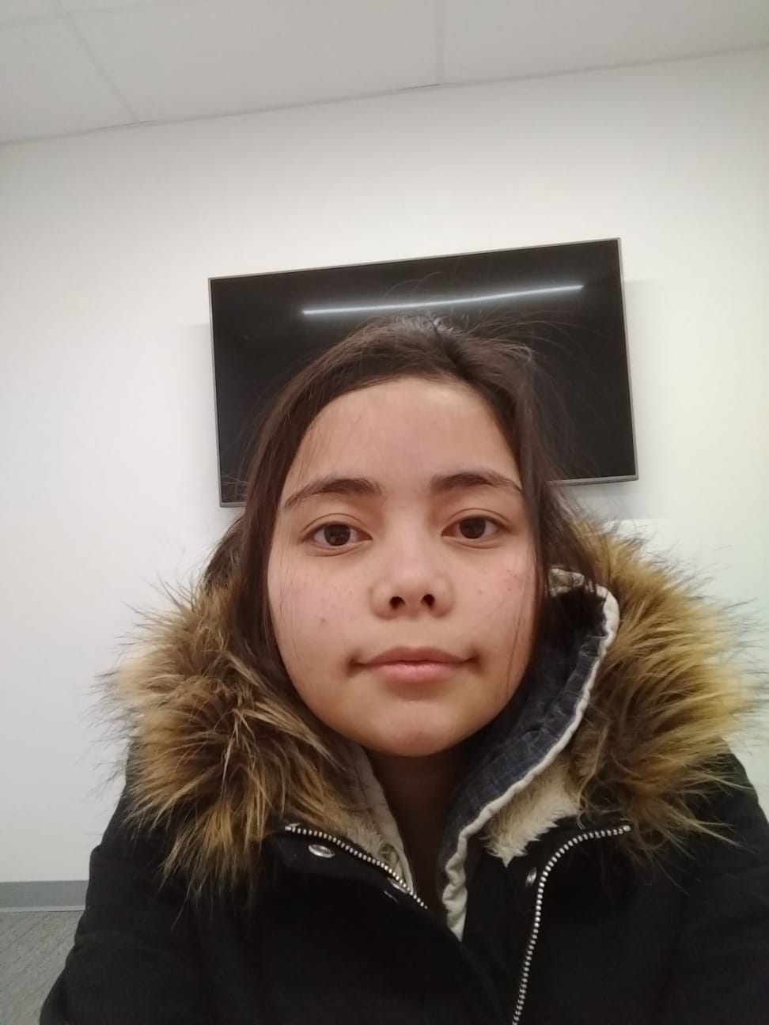
Developers:
Sandy MacAskill
Felipe Mafra
Dos Santos
Jemillee Prado

Slide 5
Mentored by: Sonam Devgan

Slide 6
Entrepreneurial Project

Slide 7
Featuring: SQL Server ASP.Net HTML5, CSS3, Javascript and Jquery

Slide 8
What does it do?
Access your inventory from any web capable device
Migrate existing Excel inventory
Search for the right item at the right location
Browse entire departments
Generate a weekly re-order list
Transfer stock between locations

